Slide 1
Fitness Fit
Use expert techniques to get you in shape and feeling fit.
Collaborators
Parth,Geoffrey,Price and Alex

Slide 2
Elevator Pitch
When you look good, you feel good, you act good. Hello my name is Parth Bakhda, I am a collaborator for the phenomenal app Fitness Tracker. We started from humble beginnings, working on, and fixing the quirks that make this app such a great success. At one point we all have wondered what would I look like if I were fit? well now, stop wondering, and start doing. With our fitness app we make dreams a reality. We have a group of certified trainers and nutritionist that have studied the ins and outs of what makes working out less of hassle and more progressive with results. The app has a login page where users can sign up and register, then on to the home screen which has banners and testimonies to get you pumped up. Next is the fitness diary that lets you input your exercises, duration, and weights, then to the workout page which has preloaded workout plans. It also has progress tracker that lets you keep track of your goals and tracks your fitness regiment. Lastly an about us page that has information about the collaborators and their fitness experience and specialties so you can insure you are getting professional help with individualized treatment to help you on your goals. Be all that you were meant to be Veni Vidi Vici: I came, I saw, I conquered. Download the app now don’t wait any longer.

Slide 3
Concept
Description: Fitness Tracker is an app, that tracks your fitness goals and regiments to make sure you have the knowledge you need to stay fit, and also preloaded workouts to get results.
Motivation: We at Fitness Tracker, come from humble beginnings and all started in a garage, and quickly developed into a full grown company in light of the app success. Group of friends from different backgrounds and specialties were tired of losing family members and loved ones to obesity and health concerns associated with it so developed app to keep weight in check.
User Story: Fitness Tracker
As a Fitness Enthusiast
I want to use an app to help maintain/lower weight and gain muscle
So that I can stay healthy and look and feel great.
Also track my fitness levels and diary of workouts.

Slide 4
Process
Technologies used Visual Studio Code, GitHub, Heroku, Mysql, and Internet.
Breakdown of tasks and roles Geoffrey created the diary html, and collaborated with apis, Alex created sign in page, Parth created wireframe of app, about us page, powerpoint and readme file. Price helped with setting up some features.
Challenges we encountered, were creating a working api and getting all the features to work properly, and deploying to heroku but making sure all components were aligned properly.
Successes we encountered, was creating a properly working index, about us, diary and working html also css, lastly javascript.

Slide 5
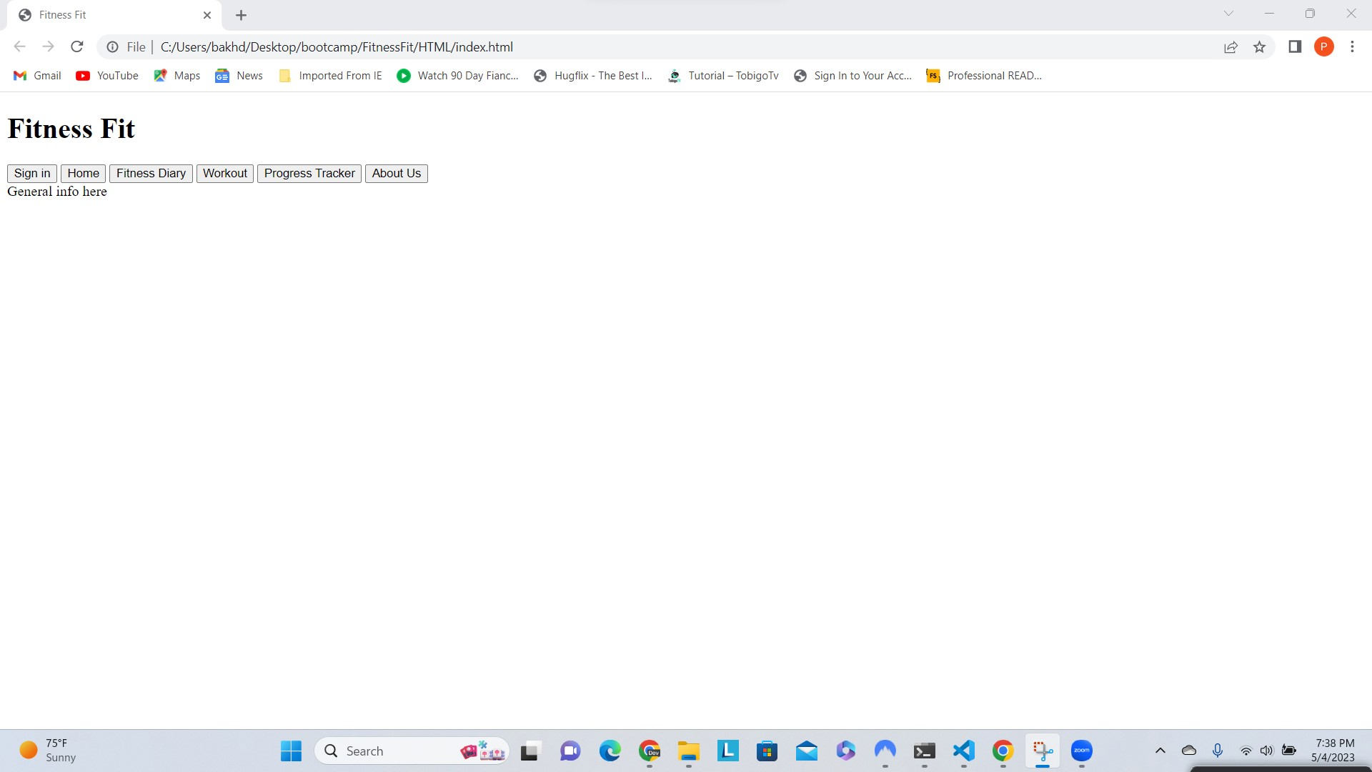
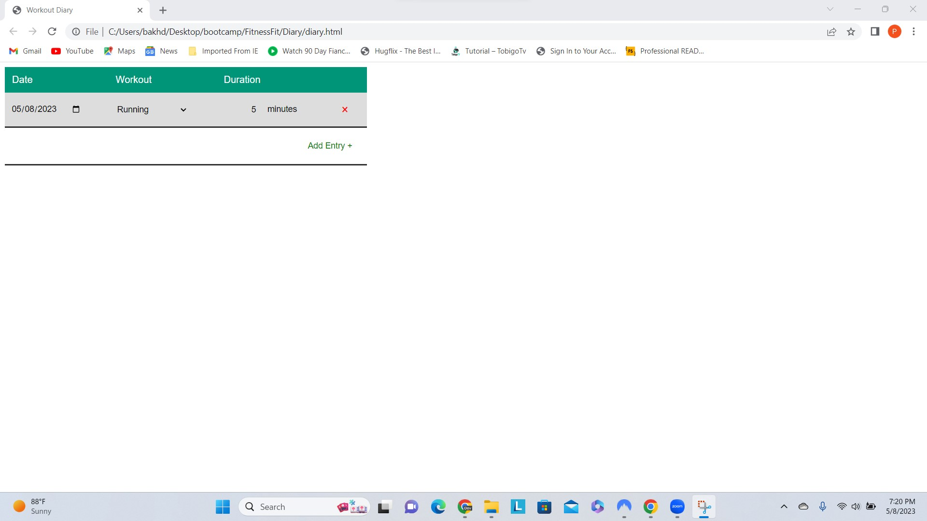
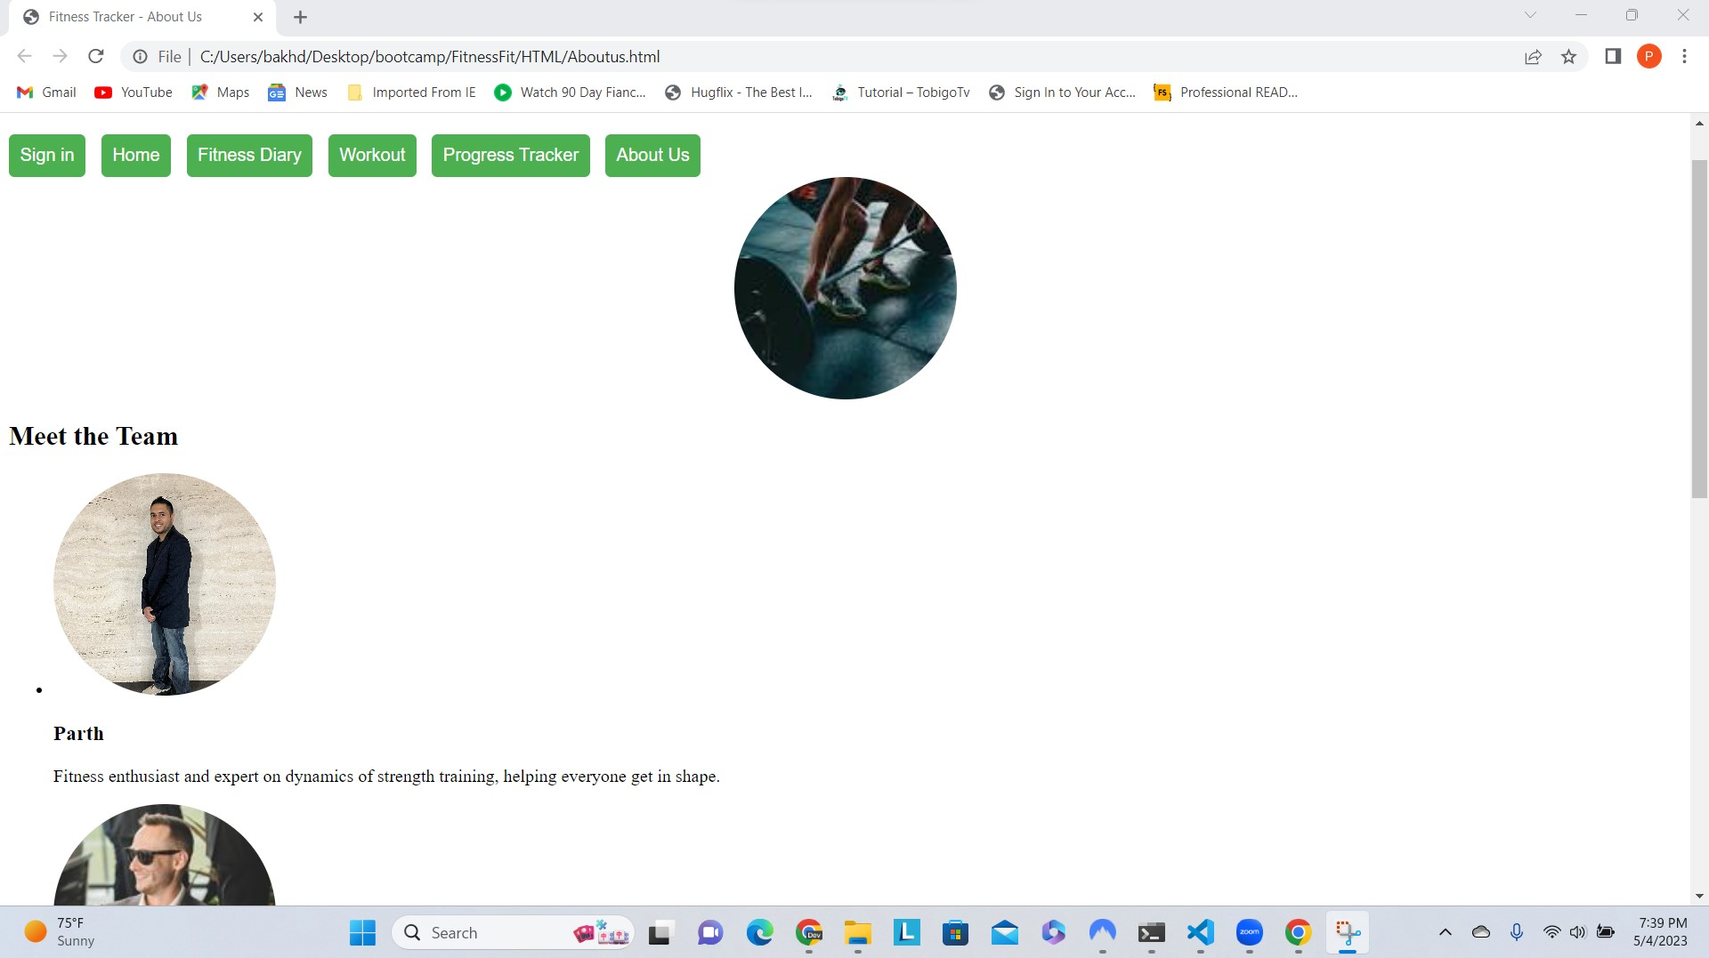
Demo
Initial Index home screen page.
Fitness Diary with working date, minutes and exercise input.
About us page with collaborators and information about them.

Slide 6
Directions for future development
In the future we would like to incorporate a group chat feature where users can chat with each other and get updates.
We would like to create a nutritional intake out and outtake post where user can update and edit their nutritional plans and pick and choose which plan is best for them.
Incorporate a fitness gym locator to find fitness centers close to your area.
Create a fitness buddy feature where you can find fitness workout buddies close to your area.

Slide 7
Links
https://www.w3schools.com/js/js_api_intro.asp
https://www.w3schools.com/html/html_css.asp
https://www.w3schools.com/html/html_scripts.asp
https://www.w3schools.com/css/css_dimension.asp
https://www.w3schools.com/js/js_variables.asp
https://www.w3schools.com/js/js_const.asp
https://www.w3schools.com/js/js_arrays.asp

